Slide 1
Steganography Application

Slide 2
Agenda
What is Steganography
Hiding in audio
Hiding in text
Hiding in images
Hiding in video
Library's used and Tools

Slide 3

What is Steganography ?
Steganography is the practice of concealing information or messages within other, seemingly innocuous objects or files. The primary goal of steganography is to keep the very existence of the message hidden, unlike encryption, which focuses on making the content unreadable without a key

Slide 4
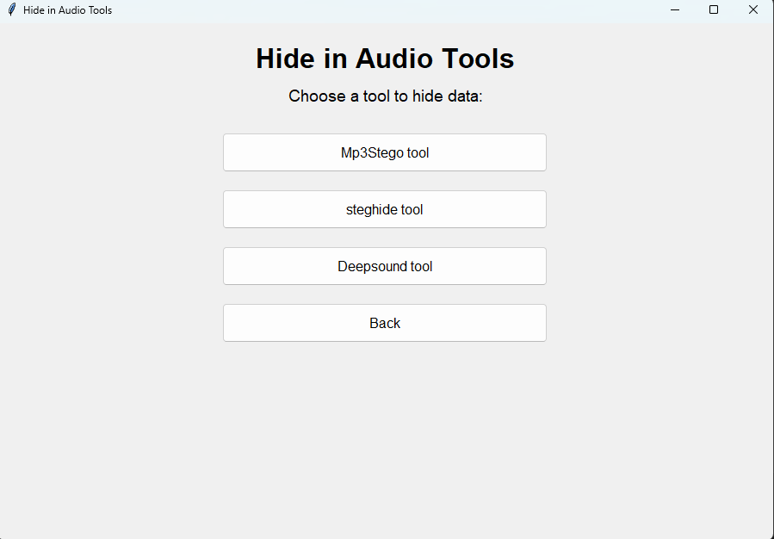

Hiding in audio Tools:
Tools we used :
mp3 stego
Steghide
Deepsound Tool
And this is photo from out application:

Slide 5
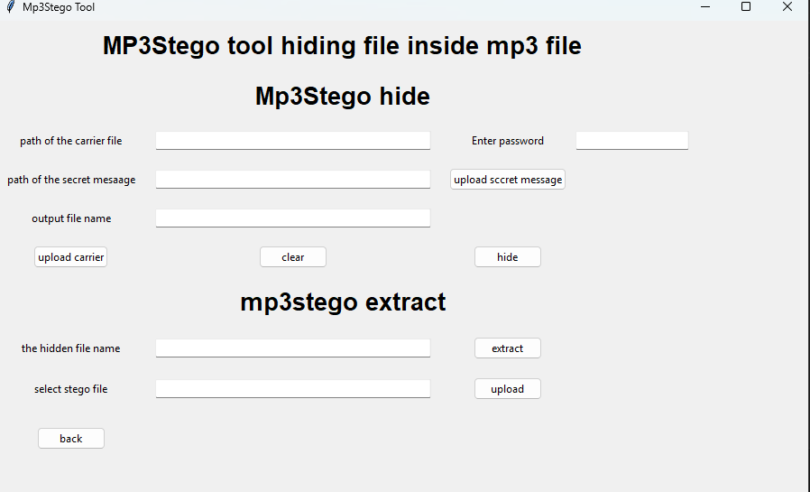
Continue:
Mp3Stego Hiding data inside mp3 file but how it Work ?
We make a very simple UI to deal with this tool.
As we see we want from the user in hiding:
Carrie file and this file is .WAV file
And password for encryption
The hidden message file
Output name the stego file and it should be .MP3 file
For extracting we need only the stego file and the password only

Slide 6
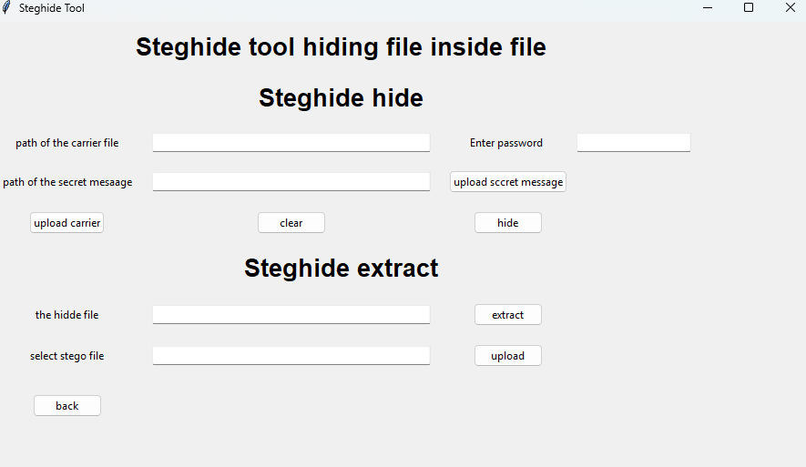
Steghide Tool:
Steghide hide data inside .WAV file also but how ot work ?
As we see we want from the user in hiding:
The carrier file
Password for encryption
The hidden file
But this tool does not need any out put file this hide inside the carrier file it self
For extracting we need only the stego file and the password only

Slide 7
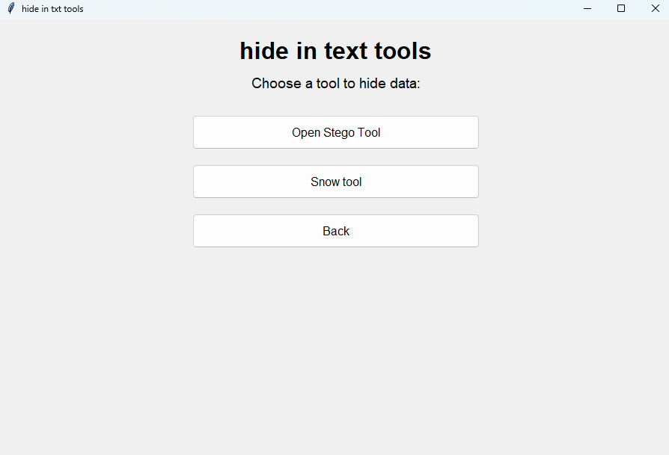
Hiding in text Tools
Tools we used:
Open Stego Tool (GUI)
Snow Tool (CLI)

Slide 8
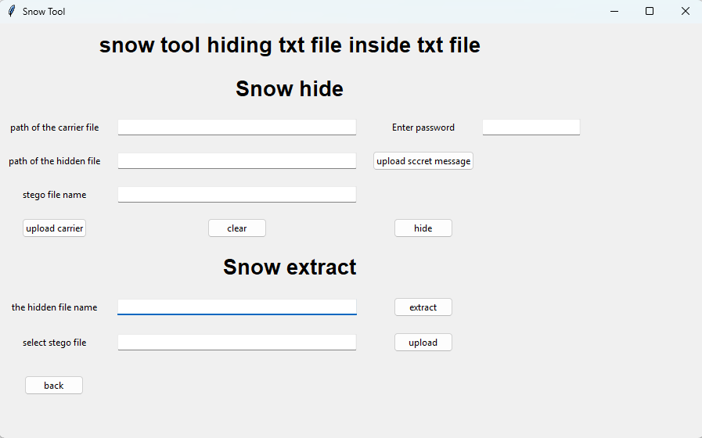
Continue:
Snow Tools hide text file inside text file and how it work ?
It take a plain text file and hidden file message and embed the hidden inside the plain text file and produce file stego file contain the plain text file and hidden not viewed
As we see we want from the user in hiding:
Carrie file and this file is .txt file
And password for encryption
The hidden message file .txt
Output name the stego file and it should be .txt file
For extracting we need only the stego file and the password and the name of the output file you want.

Slide 9
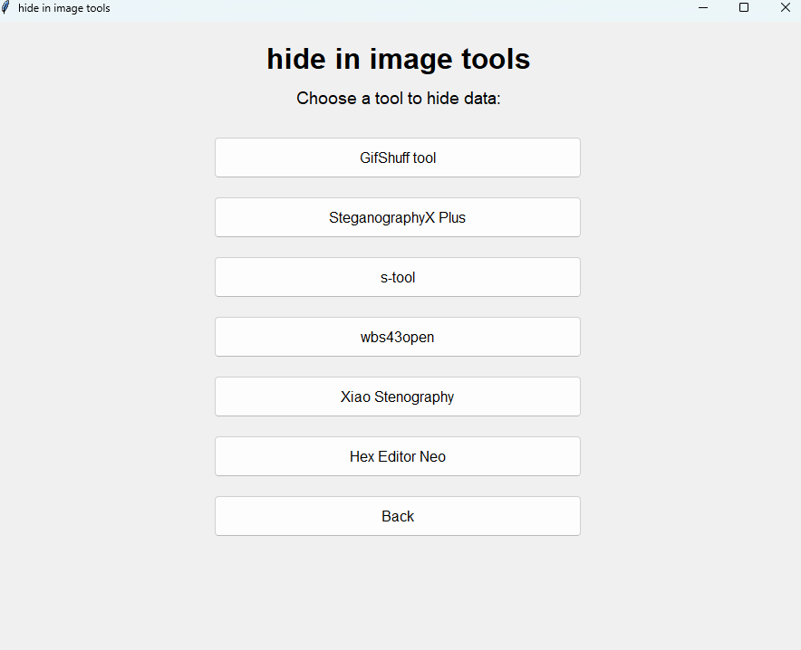
Hiding in image:
Tools we used:
GifShuff (CLI)
StenographyX plus(GUI)
S-tool(GUI)
Wbs43open(GUI)
Xiao Steganography(GUI)
Hex Editor neo(GUI)

Slide 10
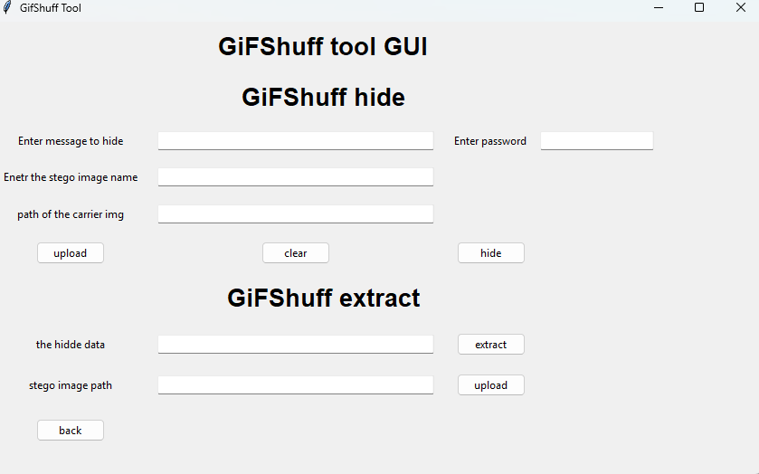
GifShuff tool:
GifShuff hide string inside Gif photo but how to work?
It take message ad string from the user and embed it the image without any corruption of the new GIF image that will produce
As we see we want from the user in hiding:
Carrie file and this file is .GIF file
And password for encryption
The hidden String message
Output name the stego file and it should be .GIF file
For extracting we need only the stego file and the password and the string will extract in the hidden data field

Slide 11
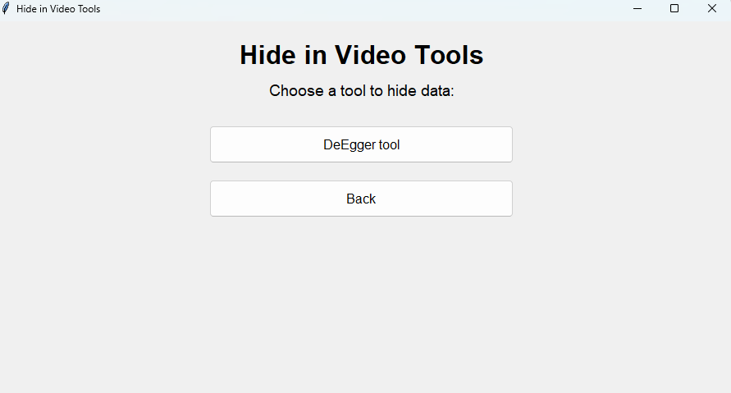
Hiding in video:
Tools we used:
DeEgger Embedder Tool(GUI)

Slide 12
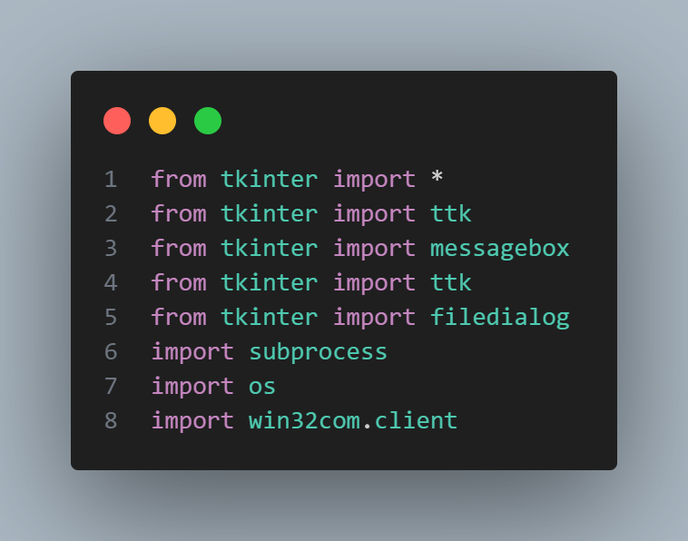
Library an tools used:
Tkinter to build the UI
Subprocess to deal with the CLI and GUI tools and
os to deal with the operating system
Win32com for deal with windows API for some application

Slide 13

Any Q&A
Contact us from the link of the application
For any issues and manuals visit:
https://github.com/E0xMomen/Stegnography-project

Slide 14
Thank you

